Slide 1






Mock
Bootloader
Team: 1
Vũ Duy Phúc
Vũ Hải Đăng
Nguyễn Hoàng Sơn
Nguyễn Hữu Trị

Slide 2




Introduce
Bootloader is a special software that is loaded into the computer's memory before booting.
Bootloader is no different from a pre -loaded firmware in that microprocessor, and is called every time the computer starts.

Slide 3

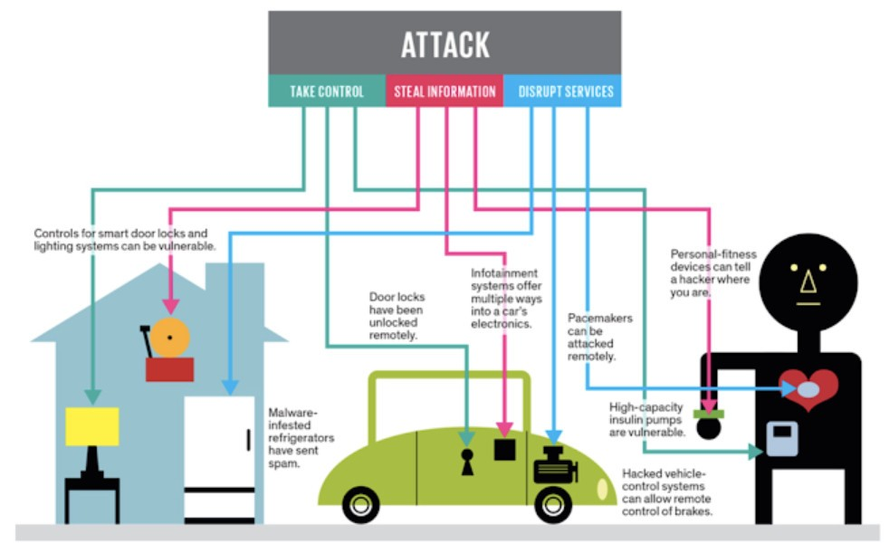
Why need bootloader?
To develop a product for users, especially IoT products, the update of firmware is very important. We need another method of updating firmware and bootloader is the core of the problem. The second reason we need bootloader is due to security, absolutely important for embedded/iodine products.

Slide 4

Why is it important to understand HEX file structure?
We are working with bootloader, so loading the code will not be through some software or IDEs that we have to load the code via wireless network or through the UART, SPI, I2C protocols. So we have to analyze the Hex file itself and then record it in Flash with the desired address

Slide 5
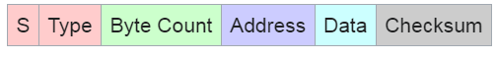
Byte count: two hex digits ("00" to "FF"), indicating the number of bytes (hex digit pairs) that follow in the rest of the record (address + data + checksum). This field has a minimum value of 3 (2 for 16-bit address field plus 1 checksum byte), and a maximum value of 255 (0xFF). "00" / "01" / "02" are illegal values.
Address: 4 digits, this is the offset address, this address plus the base address (we can choose) will go to the address where the data is loaded to the flash memory.
Data: This part is the data that will save on the flash, the number of bytes will be specified at the byte Count field.
Checksum: Including 2 digits, used to check the error. As a rule, a line will be true when the byte checksum will be equal to the island of all the remaining bytes of the same line, plus 1.

Slide 6

Flash memory operation
With the bootloader application, we need to consider what we need to write and where to write
Flash memory operation also works in storing some important data, but when reset (due to power outages or something), that data will not be lost because Flash is the type of Non-Volatile memory.
There are 3 main operations with flash memory: Read, Write, Erase

Slide 7
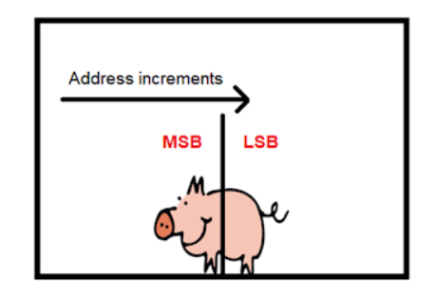
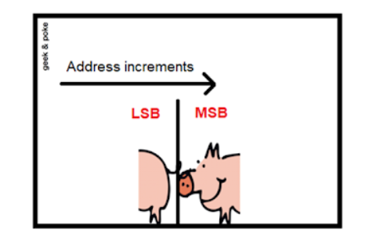
Endianess
Big Endian
Little Endian

Slide 8
Impelment Project
Project
Application
Receive and Parse SREC Data
Bootloader

Slide 9
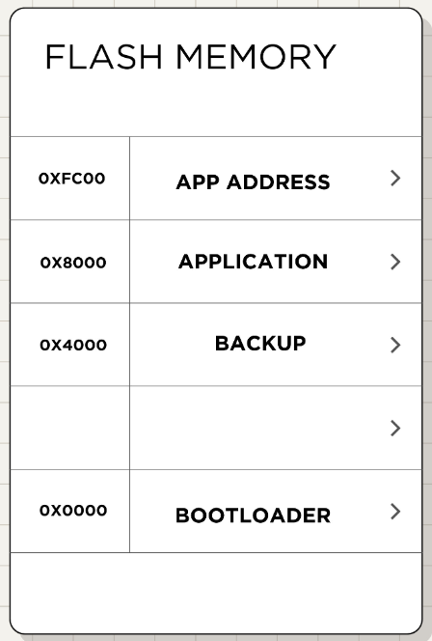

Slide 10
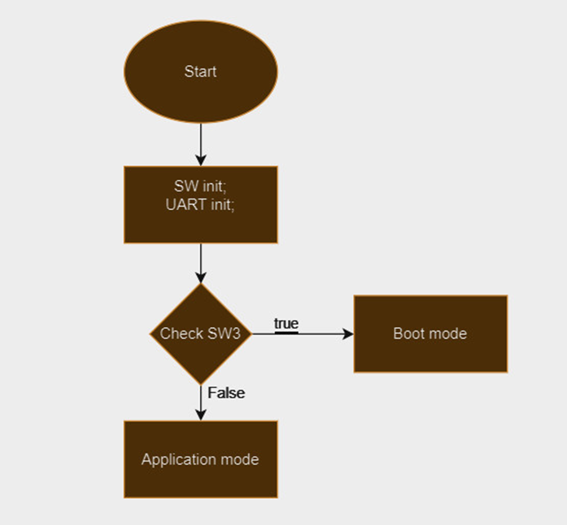
Boot Loader Flow

Slide 11
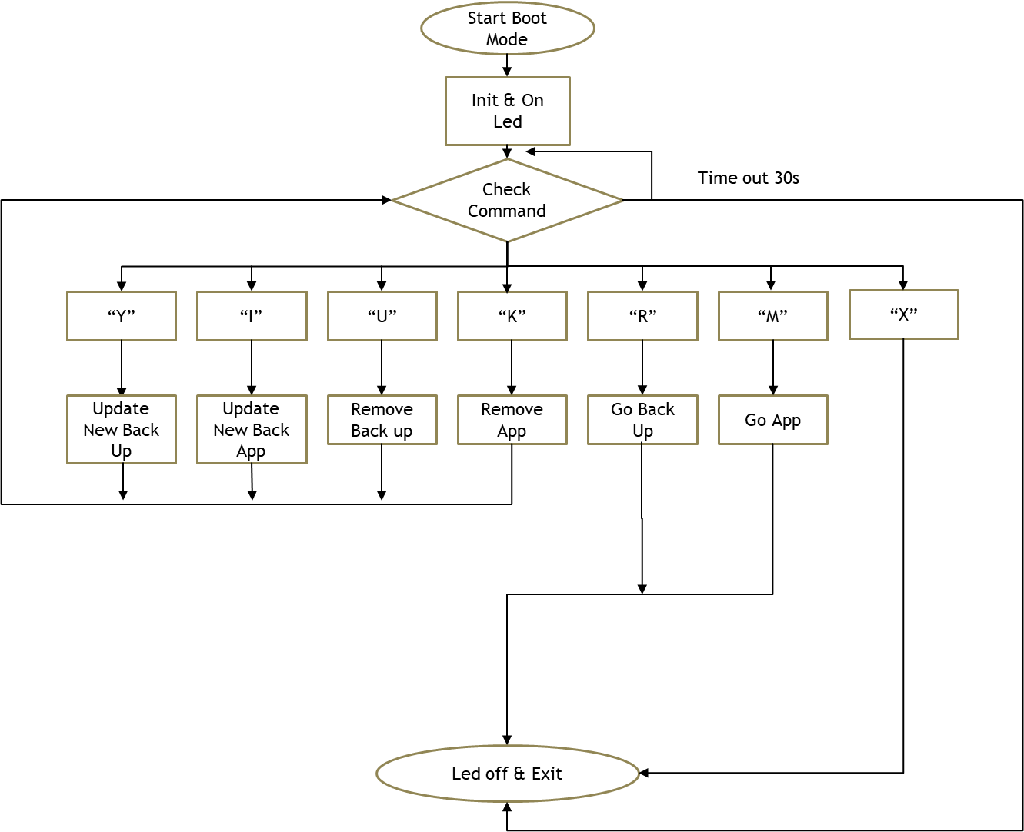
Boot Mode

Slide 12
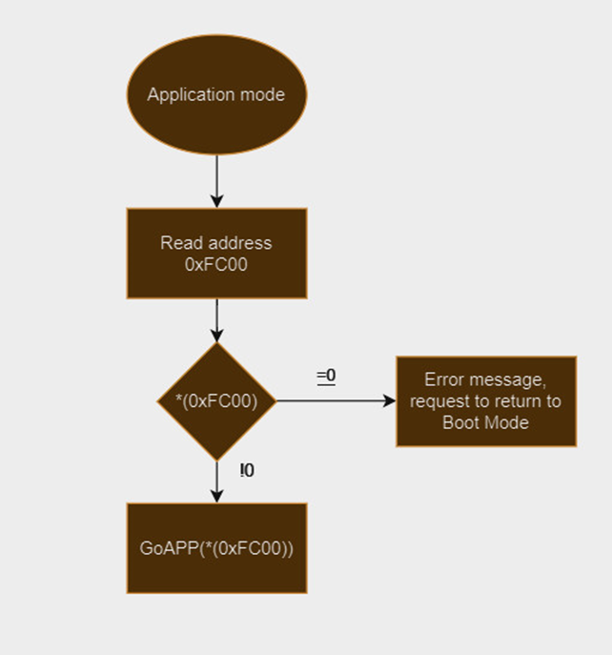
Application Mode

Slide 13
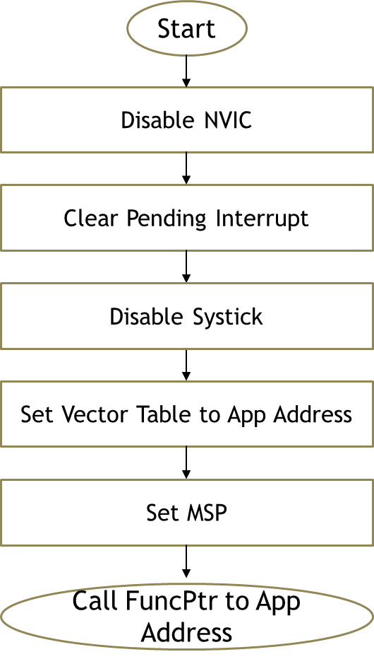
Jump to App

Slide 14
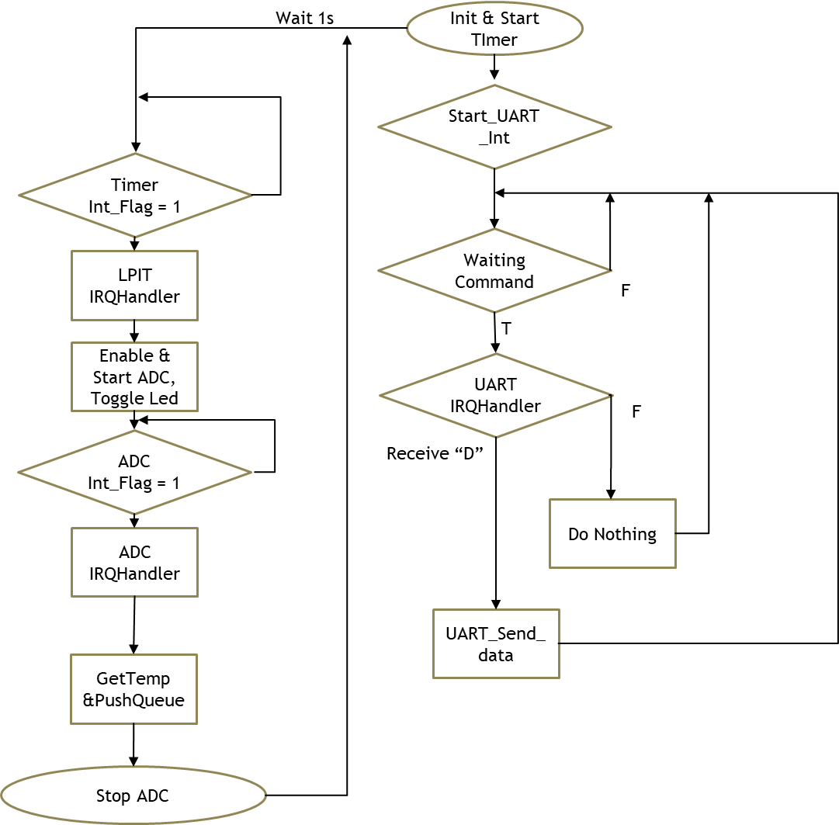
Application Flow

Slide 15
Thank
you!

